Slide 1
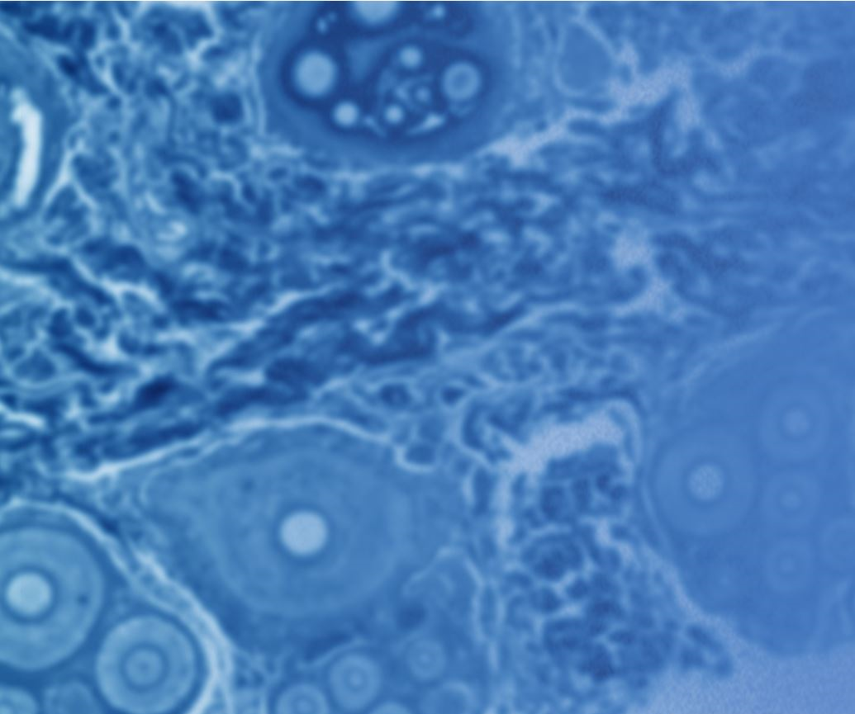
Finding Cures Faster – Nuclei Detection with Deep Neural Networks
Leveraging cloud-based machine learning at-scale on AWS

Slide 2
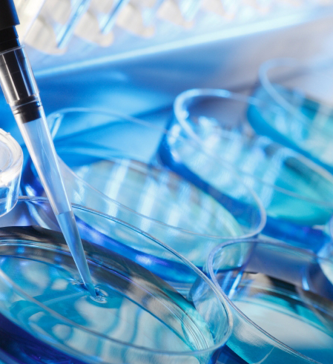
Why does it take 10 years to bring a cure or treatment to market?
“Imagine speeding up research for almost every disease, from lung cancer and heart disease to rare disorders. The 2018 Data Science Bowl offers our most ambitious mission yet: create an algorithm to automate nucleus detection and unlock faster cures.”
- Dr. Anne E. Carpenter, Broad Institute of MIT and Harvard.

Slide 3
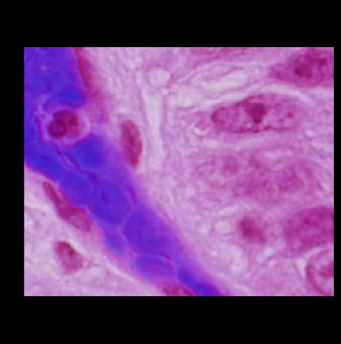
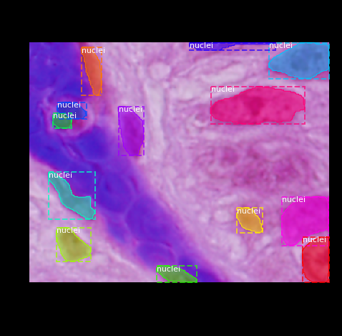
Unlabeled (source)
Segmented & annotated

Slide 4
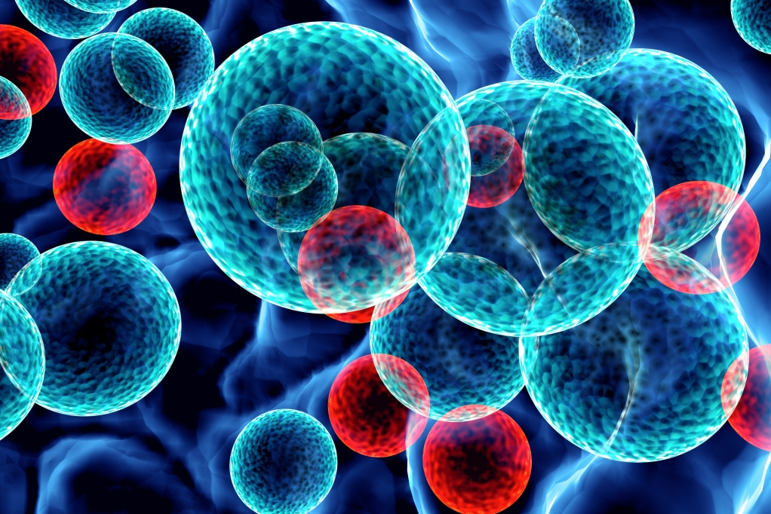
Where do we start? With the source data, of course…
Variety of nuclei shapes, microscopy techniques, and other imaging issues
Mask issues: some missing, some false-positives, overlapping / blending
Cell apoptosis, blebbing and karyorrhexis (fragmentation of nuclei)
Only 670 source images provided; augmentation required!
Compute demands for imaging and deep neural-networks are significant.
And more…

Slide 5
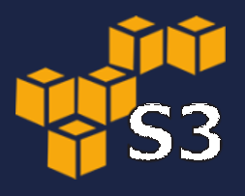
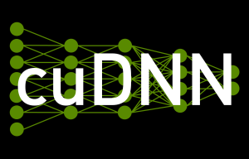








The price of admission: convolutional neural networks
32
dropout
eLU activation (hidden layers)
sigmoid function (final layer)
dropout
$$f\left(x\right)= \left\{\begin{aligned}&x x≥0 \\ &α\left(e^{x}−1\right) x<0\end{aligned}\right.$$
$$S\left(x\right)=\frac{1}{\left(1+e^{−x})\right.}$$
256 x 256 x 3
256 x 256 x 16
256 x 256 x 16
dropout
loss function: binary cross-entropy
256 x 256 x 16
256 x 256 x 16
256 x 256 x 1
$$0.1≤ⅆ_{i}≤0.3$$
$$−\left(y∗\log\left(p\right)+\left(1−y\right)∗\log\left(1−p\right)\right)$$
32
32
64
32
dropout
data augmentation
dropout
128 x 128 x 16
128 x 128
128 x 128
128 x 128 x 32
64
64
parallel GPU processing
128
64
64 x 64 x 32
64 x 64
dropout
64 x 64
dropout
64 x 64 x 64
32 x 32 x 64
128
128
256
128
32 x 32 x 128
conv 3x3 w/ $λ$ (norm)
dropout
dropout
conv 3x3, eLU
max pool 2x2
256
up-convert 2x2
16 x 16 x 128
DO
conv 1x1
16 x 16
16 x 16

Slide 6
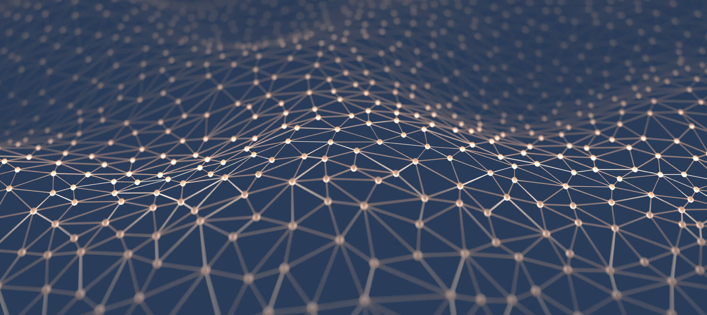
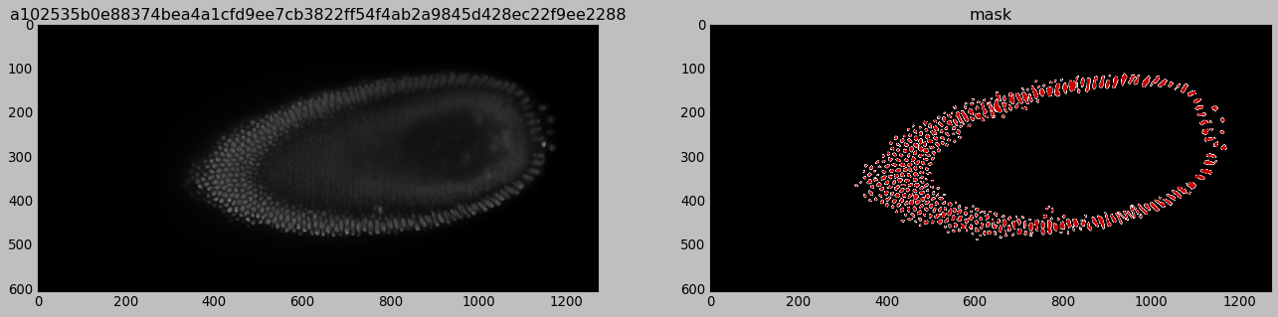
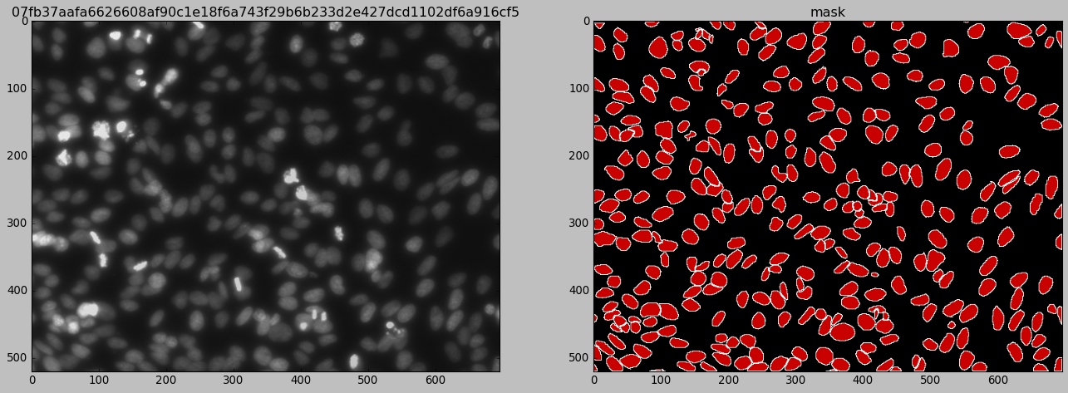
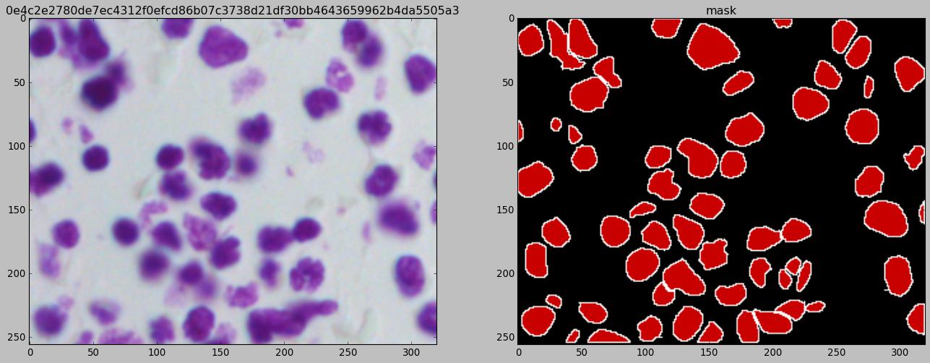


Progress (so far)
$$IoU\left(A,B\right)= \frac{|A∩B| }{|A∪B|}$$
A
B
$$∩$$

Slide 7
Thank you

